Slide 1

TOLUWASE OLUWASEUN 100916734 December 2023
STATISTICAL AND PREDICTIVE MODELING FOR ANALYTICS II (DATA 2204)

Slide 2
Rational Statement
Overview of Models
A Logistic Regression: This type of statistical model is often used for classification and predictive analytics. We will be using Logistic regression to to rightly forecast the stability label of a system , based on a given dataset of independent variables.
There are four assumptions key assumptions of the logistical regression models
Observation are independent of each other:
Little or No multicollinearity among the independent variable
Assumes linearity of independent variables and log odds.
Large Sample Size.
The Naïve Bayes works on conditional probability. Conditional probability is the probability that something will happen, given that something else has already occurred. Using the conditional probability, we can calculate the probability of an event using its prior knowledge.
The Voting Ensemble is one of the simplest way of combining the predictions from multiple machine learning algorithms. It works by first creating two or more standalone models from your training dataset. A Voting Classifier can then be used to wrap your models and average the predictions of the sub-models when asked to make predictions for new data.

Slide 3
Rational Statement
This powerpoint presentation shows the use of Logistical Regression, Naïve bayes and Voting Esemble model for Mr John Hughes MHR_ dataset to rightly forecast the stability label of the system .
The dataset consist of 10,000 observations and 14 variables.
Independent variables
Tau[1-4] - reaction time of participant (real from the range [0.5,10]s). Tau1- the value for electricity producer.
p[1-4]: nominal power consumed (negative)/produced(positive)(real). For consumers from the range [-0.5, -2]s^-2; pl = abs(p2 + p3 + p4)
g[1-4]: coefficient (gamma) proportional to price elasticity (real from the range [0.05,1]s^-1). g1 – the value for electricity producer.
stab: the maximal real part of the characteristic equation root (if positive – the system is linearly unstable)(real)
Dependent variables
Stabf – the stability label of the system (stable/unstable )

Slide 4
Rational Statement
The presentation will employ exploratory data analysis (EDA) by developing Pandas Profiling report. We will identify and explain at least 3 key insights from the UCI_Dataset.csv dataset from the Pandas Profile.
Though not reflected in our slides, isolation forest was used to remove anomalies in our dataset.
We will develop two learning curves for the Logistic regression and the Gaussian Naïve Bayes and explain two key insights from each of them.
We will create the optimized models for The Logistical regression and Naïve Bayes. We will present the resulting Classification Report and ROC/AUC of each optimized model and explain 3 insights of each.
For our Ensemble voting model, we will explain the result and compare it to the other two optimized model.
We will recommend one of the model to Mr. John Hughes and suggest two next steps that could help enhance the usability of the model.

Slide 5
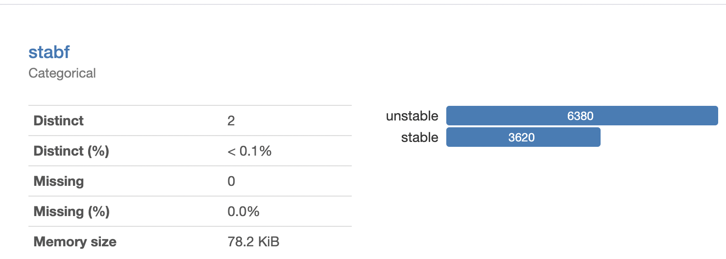
Insights from our Pandas Profiling Report
The Pandas Profiling Report showed that we have two distinct independent variable and there is exist class imbalance. The unstable observation as 6380 and stable is 3620. The dependent variable is categorical.

Slide 6
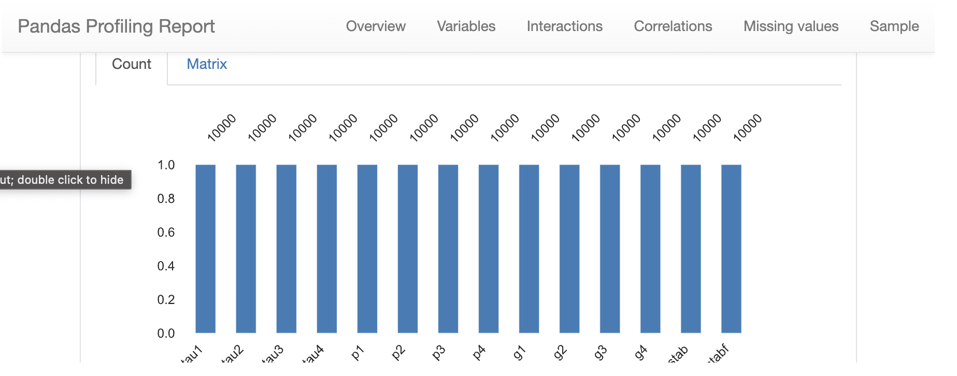
Insights from our Pandas Profiling Report
The Pandas Profiling Report affirms that there are fourteen (14) variables in total. It also shows that there are no missing data with all variable having 10,000 observations each.

Slide 7
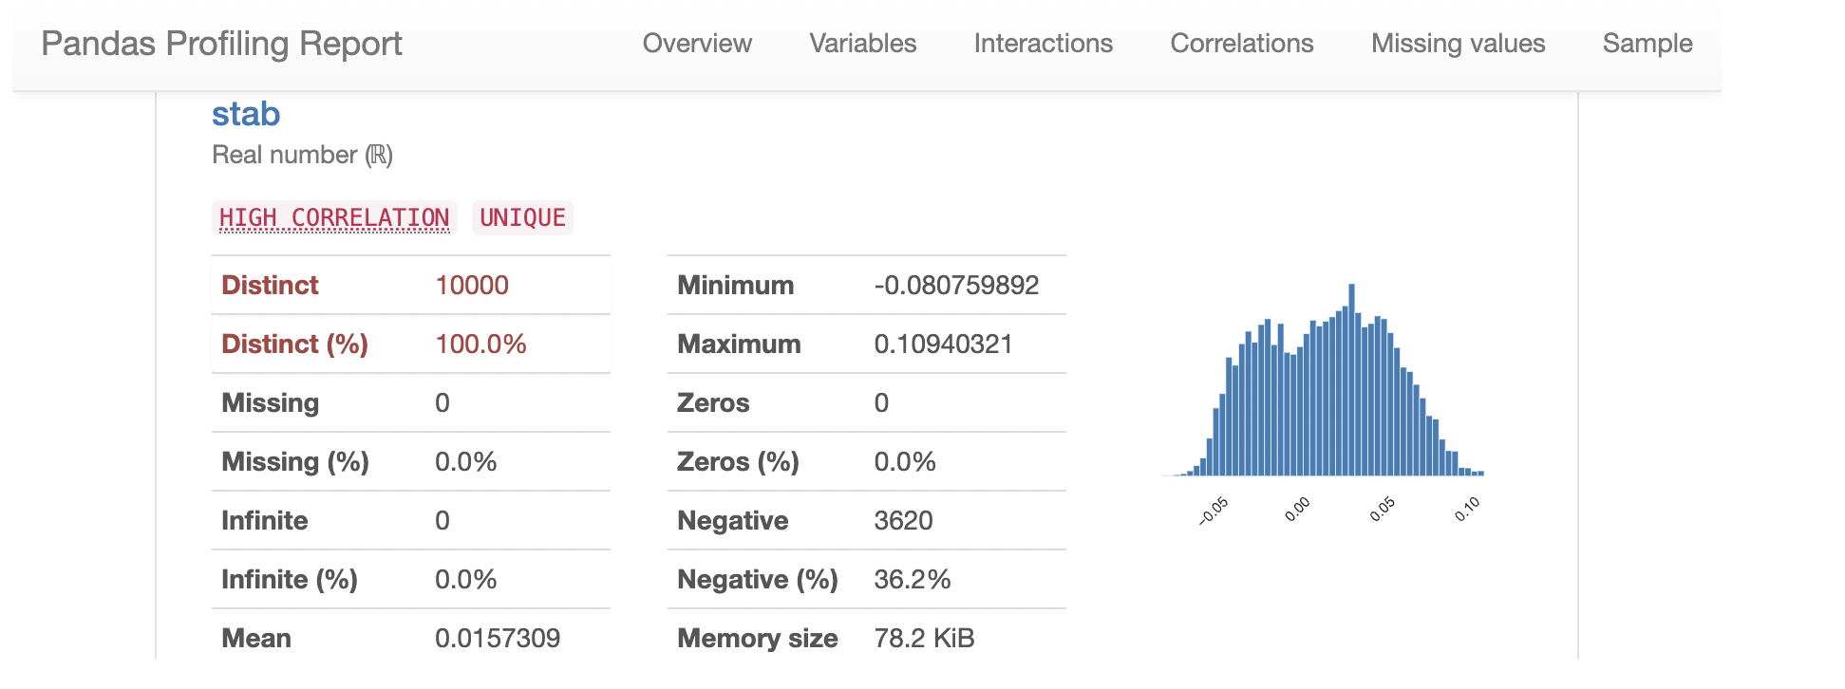
Insights from our Pandas Profiling Report
There is high correlation in the stab independent variable, it has a maximum value of 0.109 and a minimum value of -0.08. the stab variable also has a mean value of 0.016.
Other Insights:
All the independent variables are numerical while the dependent variable is categorical.

Slide 8
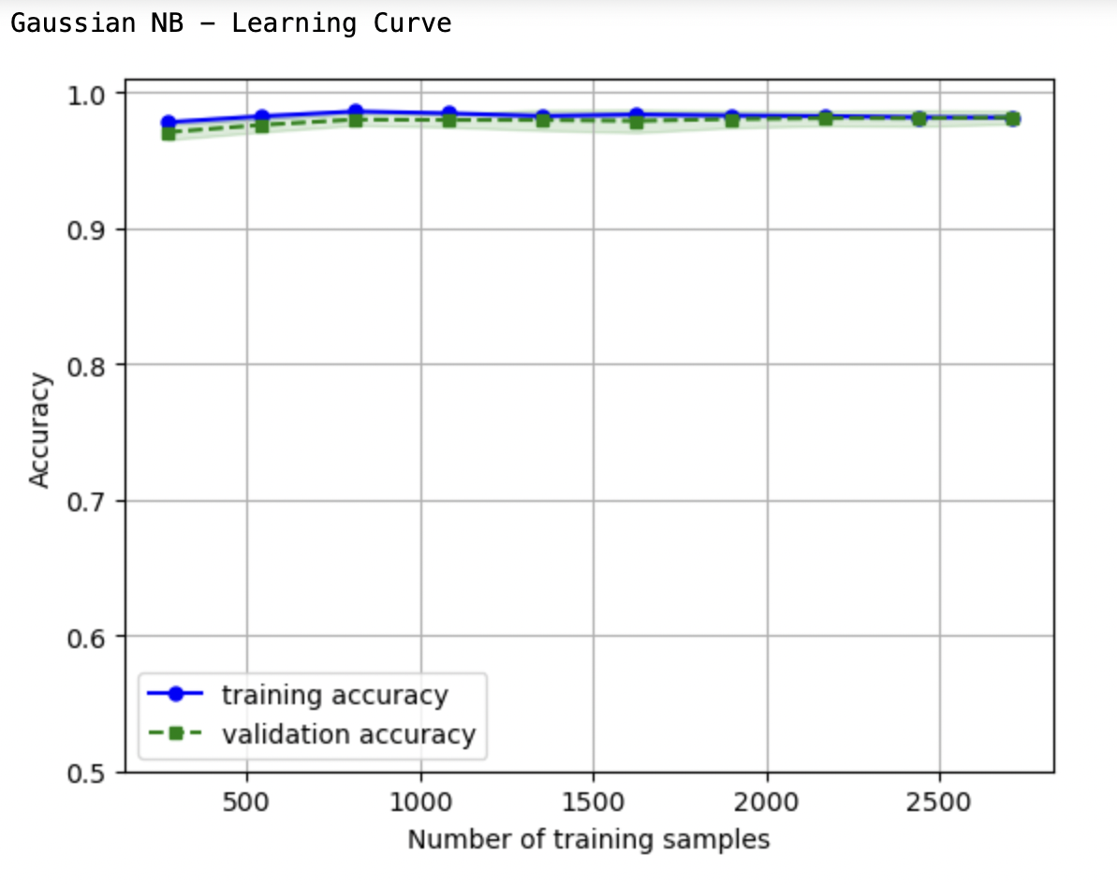
Gaussian Naïve Bayes
High accuracies from 250 to 2600 samples indicate effective learning, potential data saturation, or model convergence. Sufficient data might contribute to quick convergence. Evaluate metrics, consider regularization, and experiment for improvement.
There is a lack of significant changes in the training and validation curves, suggesting that increasing the training samples beyond a certain threshold does not notably enhance the model's performance.

Slide 9
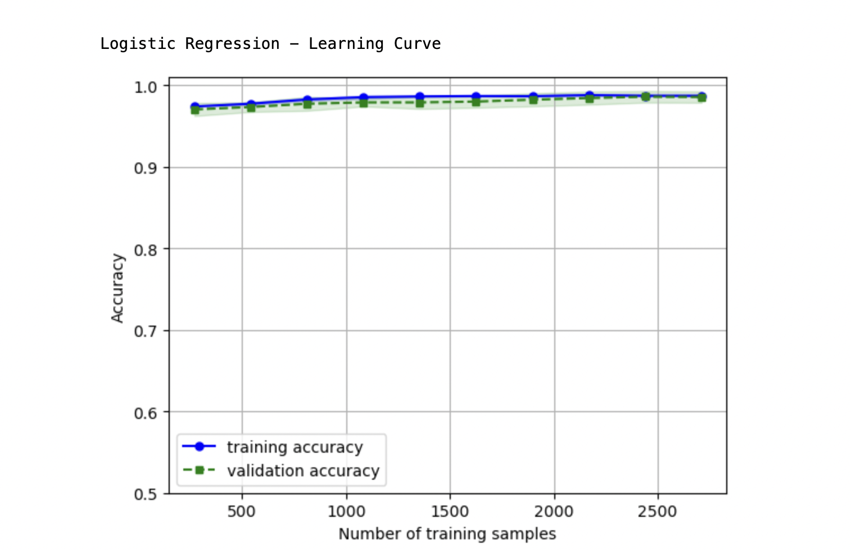
Logistic Regression
From about 200 training sample, as the training sample increases, the training and validation follow each other with high accuracy. The training set does not learn much after this point.
Accurate performance from 200 to 2600 training samples suggests effective learning, possible data saturation or model convergence. Having sufficient high-quality data may contribute to rapid convergence. We may need to evaluate metrics, explore regularization, and experiment for enhancements.

Slide 10
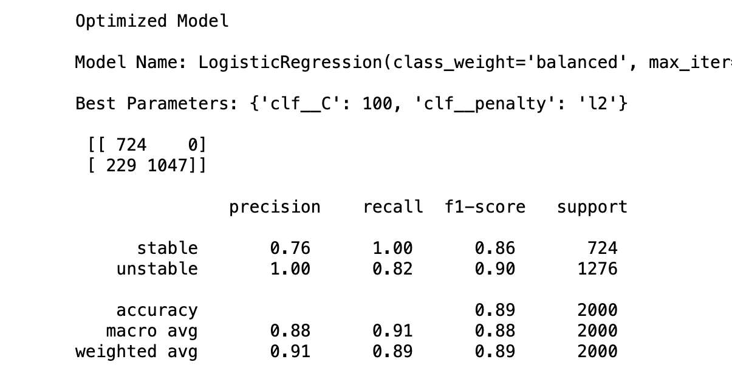
LOGISTIC REGRESSION CLASSIFICATION REPORT
The summary table showed that
it rightly predicted 724 (True positive)
Rightly classified 1047 (True positive) unstable but wrongly classified 229 unstable as stable.
Insight
Accuracy: This depicts the general accuracy of the model; the ratio of correct predictions to total predictions. The model has an accuracy of 0.89
Precison: This depicts how precise the model is. It shows how often the model is correct when it makes a prediction. The model has a precision of 0.76 and 1.00 for stable and unstable respectively with an average model precision of 0.88.
Recall: This depicts the ratio of correctly predictive positive observations to all observations in the actual class. The model has a recall of 1.00 and 0.82 for stable and unstable respectively with an average model recall value of 0.91
F1: This depicts the harmonic mean of the precision and recall. The model has a f1 Score of 0.86 and 0.90 for stable and unstable respectively

Slide 11
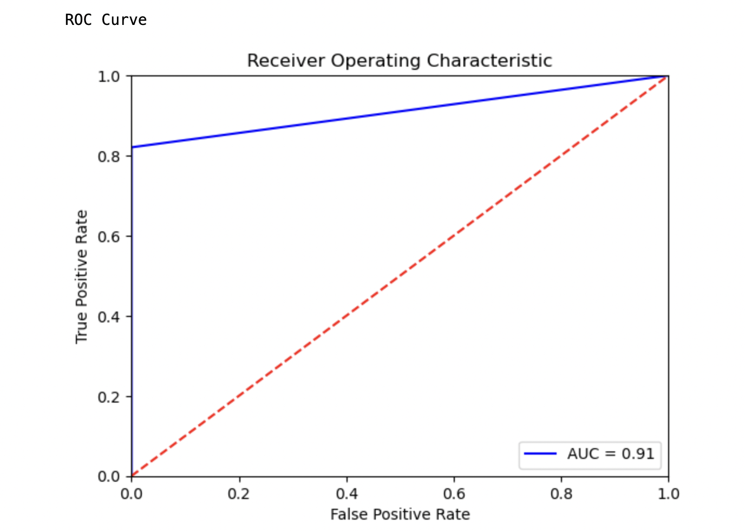
LOGISTIC REGRESSION ROC/AUC
The AUC (Area Under Curve) represents the area between the ROC curve and the axis. It is the area covered by the curve between the blue line (ROC) and the axis. A larger AUC, such as 0.91 in our Logistic Regression model, indicates better predictive performance, affirming the model's strong discriminatory ability. The bigger the area covered, the better the prediction.

Slide 12
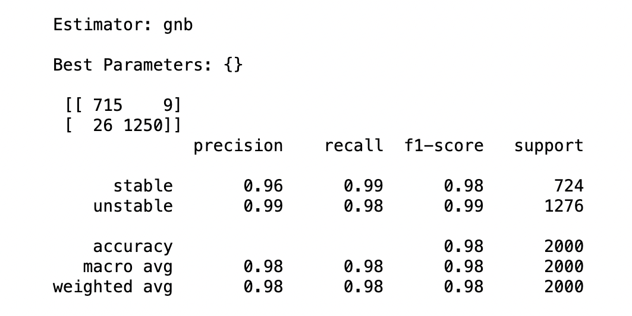
NAÏVE BAYES CLASSIFICATION REPORT
The summary table showed that
it rightly predicted 715 (True positive)
Rightly classified 1250 (True positive) unstable but wrongly classified 26 unstable as stable.
Insight
Accuracy: This depicts the general accuracy of the model; the ratio of correct predictions to total predictions. The model has an accuracy of 0.98
Precison: This depicts how precise the model is. It shows how often the model is correct when it makes a prediction. The model has a precision of 0.96 and 0.99 for stable and unstable respectively with an average model precision of 0.98.
Recall: This depicts the ratio of correctly predictive positive observations to all observations in the actual class. The model has a recall of 0.99 and 0.98 for stable and unstable respectively with an average model recall value of 0.98
F1: This depicts the harmonic mean of the precision and recall. The model has a f1 Score of 0.98 and 0.99 for stable and unstable respectively

Slide 13
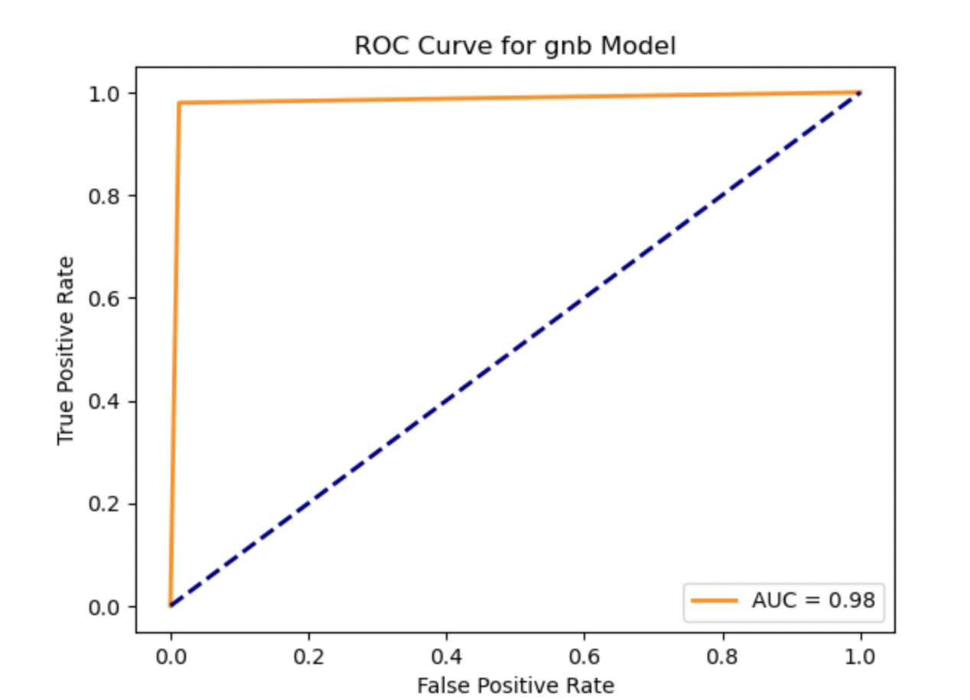
NAÏVE BAYES ROC/AUC
The AUC (Area Under Curve) represents the area between the ROC curve and the axis. It is the area covered by the curve between the blue line (ROC) and the axis. A larger AUC, such as 0.98 in our Naïve bayes model, indicates better predictive performance, affirming the model's strong discriminatory ability. The bigger the area covered, the better the prediction. The Naïve Bayes model perfroms better than the Logistic Regression.

Slide 14
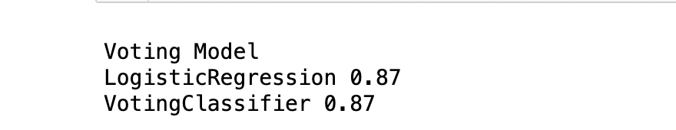
COMPARING LOGISTIC ENSEMBLE VOTING MODEL WITH OPTIMIZED LOGISTIC MODEL
Logistic Regression is effective for binary classification, modeling the probability of class membership. Earlier we saw that the optimized model had an accuracy of 89%.
With the Voting Classifier, combining multiple models,the accuracy of the logistic regression showed an 87% accuracy. This highlights the importance of considering diverse metrics for a comprehensive evaluation.
Optimized Models | Accuracy % | Ranking
Guassian Naïve Bayes | 98 | 1
Logistic Regression | 89 | 2
Ensemble Voting Classifier | 87 | 3
Comparing Models
The Result of the Logistic regression in the Ensemble model showed a result of 87% acccuracy which is lower by 2% of the Optimized Logistic Regression that recorded an accuracy of 89%. Guassian Naïve Bayes however recorded the highest accuracy of 98%.

Slide 15
ADABOOST CLASSIFIER
The Stacking Model combines the Logistic Regression (0.87) and AdaBoost Classifier (0.91). It demonstrated varied accuracies, with AdaBoost outperforming Logistic Regression, emphasizing the effectiveness of the ensemble methods. The stacking model had a general accuracy of 0.87
Stacking Model
LogisticRegression 0.87
AdaBoostClassifier 0.91
StackingClassifier 0.87
Optimized Models | Accuracy % | Ranking
Guassian Naïve Bayes | 98 | 1
AdaBoostClassifier | 91 | 2
Logistic Regression | 89 | 3
Ensemble Voting | 87 | 4
Comparing Models
Employing the boost technique, Adaboost Classifier was able to achieve an accuracy of 91% ranking 2nd to the Guassian Naïve Bayes. The Optimized Logistic regression is 3rd with an accuracy of 89% while the ensemble voting classifier has an accuracy of 87%.

Slide 16
Recommendation
I will recommend Naïve Bayes because it has the highest accuracy of 98% and Area under the curve of 98%, it is also simple and easy to use, it is fast in training and prediction and can handle high dimensional data. It also possesses robustness to it=rrelevant features and works well with categorical data.
In order to enhance the usability of this model, we could
Feature Selection: We may implement feature selection methods like Recursive Feature Elimination or Sequential Feature Selector to assess the importance of each feature. Redundant or less relevant features may be excluded, and new, previously unidentified features could be added. This process aims to emphasize the model's focus on the most crucial factors.
Class Imbalance Handling: Address the class imbalances in the dataset using techniques like oversampling, undersampling, or using weighted classes.
To ensure the model remains operational, Mr. John Hughes should consistently test and validate it with new data, employing strategies like cross-validation.
Establish a Model Monitoring mechanism to track the model's progress over time. A decline in performance may signal the need for updates or retraining due to changes in the underlying data distribution.
Mr. John should establish a feedback loop with end users or domain experts for insights into the model's forecasts. This feedback can significantly improve and refine the model.

Slide 17
References
Tetikoglu, F. (2023, November). Week #3 Logistic Regression Models. Durham, Ontario, Canada: Durham College.
Tetikoglu, F. (2023, November). Week #4 Naïve Bayes and k-NN. Durham, Ontario, Canada: Durham College.
Tetikoglu, F. (2023, November). Week #6 Resampling Methods. Durham, Ontario, Canada: Durham College.
Tetikoglu, F. (2023, November). Week #7 Regularization and Feature Selection. Durham, Ontario, Canada: Durham College.
Tetikoglu, F. (2023, November). Week #9 Decision Tree and Random Forest. Durham, Ontario, Canada: Durham College.
Tetikoglu, F. (2023, November). Week 11 Ensemble Methods. Durham, Ontario, Canada: Durham College.

